Slide 1
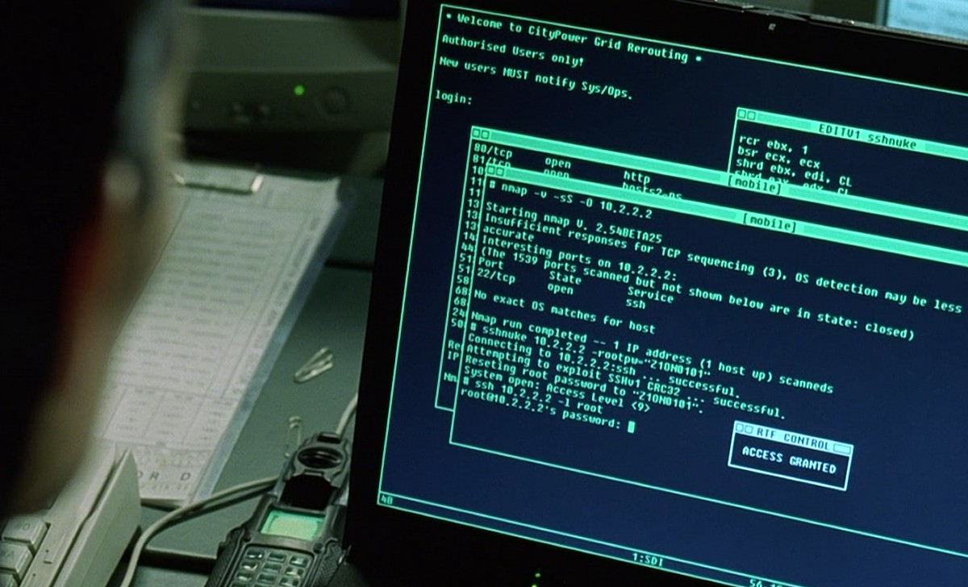
The Nmap Scripting Engine
Making Nmap work for you!
Notes:
How to penetrate a typical network, starting with the Web server and getting to each system in the DMZ
Why it works and how it could have been detected/prevented

Slide 2












Who am I...?
Notes:
Decided to take a page from Paul Asadoorian and use a collage
If I haven't scared you off, I'm here till Tuesday – if anybody wants to hang out, come find me!

Slide 3
My blog...
SkullSecurity.org
  Random research, rants, etc.
  Nmap dev news
  Password database
I post updates to Twitter
  https://twitter.com/iagox86
Notes:
Ron Bowes, security analyst, Information Protection Centre
ron.bowes@gov.mb.ca
Bayan Houshmand and Chad Kipling
Co-op students
University of Manitoba
First term

Slide 4
My job...
Tenable Network Security
  Makers of the Nessus vulnerability scanner
  I do research, reverse engineering
  Giving talks
  Plugins:
    ms10-070 remote
    ms10-075 remote
    Padding oracle checks
    ActiveSync audit (not yet released)
Notes:
Tenable is awesome - not just because they're paying for my trip here!

Slide 5
My other job...
Dash9Security.com
  Vulnerability assessment
  Penetration testing
  Training
  Etc.
Local to Winnipeg, for now

Slide 6
Nmap script – intro
Written in Lua
  Awesome embedded language
Come with Nmap
  Look for files called '*.nse' and '*.lua'
  /usr/local/share/nmap/scripts
  /usr/share/nmap/scripts
  c:\Program Files\Nmap
Expand Nmap's capabilities
  Extended version scanning, discovery, vulnerability checks, etc

Slide 7
Running scripts – Commandline
nmap --script=default 192.168.1.0/24
nmap --script=http-enum nmap.org
nmap --script=smb-enum-users
--script-args=smbuser=ron,smbpass=123456
192.168.1.2
nmap --script=safe www.skullsecurity.org
nmap --script=“(default or ftp-*) and not *http*”
10.*.*.*
Expression can be arbitrarily complex Lua

Slide 8
Nmap script – find them
NSEDoc - http://nmap.org/nsedoc
Use the Zenmap GUI
Find them on the filesystem
Use categories
  --script=default
  --script=intrusive
DEMO!
Notes:
Demo:
- Open the browser to nsedoc, browse around – show the script-args, too
- Open NSEDoc in a terminal
- Open the Zenmap gui, show the scripts.

Slide 9
New script: http-enum.nse
Web application discovery, fingerprinting
Powerful, lua-based format
  nselib/data/http-fingerprints.lua
Call to arms: we need fingerprints!
  For more information: http://www.skullsecurity.org

Slide 10
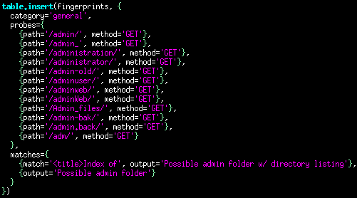
http-enum – Example 1

Slide 11
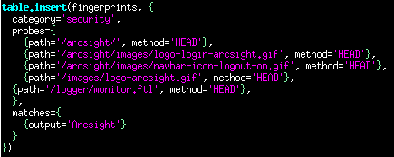
http-enum – Example 2

Slide 12
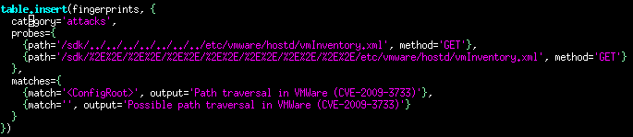
http-enum – Example 3

Slide 13

Writing scripts

Slide 14
Lua
Scripting language
Best known for World of Warcraft
Easy to learn

Slide 15
Lua
local var = 3
if(var > 6) then
io.write(“Something is weirdt\n”);
end
for i=1, 10, 1 do
io.write(string.format(“The value is %d\n”, i))
end
function max(a, b)
if(a > b) then
return a
else
return b
end
end

Slide 16
Every script needs...
Some documentation
  A description
  One or more categories
A 'rule' function
  Always called; determines whether or not the script should execute
An 'action' function
  Run when the script executes

Slide 17
“rule” function
Every script requires one or more rules:
  portrule – runs for every matching port
  hostrule – runs for every matching host
  prerule – runs before the scan
  postrule – runs after the scan
portrule = function(host, port)
return (port.number > 1024 and host.ip ~= '127.0.0.1')
end

Slide 18
“shortport” Library
Simplifies portrules
require 'shortport'
-- Run for every http server
portrule = shortport.http
-- Run for every server with port '22' or ssh
portrule = shortport.port_or_service(22, 'ssh')

Slide 19
“action()” function
action() function
  Every time one of the 'rule' functions returns true, the action() function is called.
  Return value of action() is displayed to user
    See stdnse.format_output()

Slide 20
Output...
Plain string
  Return the string from action(), done
Table data: use 'tab' nselib:
  http://nmap.org/nsedoc/lib/tab.html
Structured data or error message: use stdnse.format_output()
  http://nmap.org/nsedoc/lib/stdnse.html#format_output
When in doubt, if it's more than one line, use stdnse.format_output(),

Slide 21
Arguments to scripts
Getting arguments from users:
  stdnse.get_script_args(...)
  Takes any number of arguments, returns that many values (some may be nil if the user didn't set them)
local arg1, arg2 = stdnse.get_script_args(
'script-name.arg1',
'script-name.arg2')
-- Pick a default value for arg1 if it's not set
arg1 = arg1 or 'default_value'
-- Return an error if arg2 isn't set
if(not(arg2)) then
return stdnse.format_output(false,
“script-name.arg2 has to be set!”)
end

Slide 22
The Nmap registry
Stores data between scripts/ports (not persistent)
  nmap.registry.data = 'This can be accessed by other scripts'
-- script 1
local discovered_mac = smb.get_mac_address(host)
if(discovered_mac) then
nmap.registry['mac_address'] = discovered_mac
End
-- script 2
local mac_address = nmap.registry['mac_address']
if(mac_address) then
return “We already knew the mac: ” .. mac_address
end

Slide 23
sample-script.nse
Written as a template
Found on 'docs' folder of Nmap source
Implements best practices
All new scripts should be based on it

Slide 24
Where to get help...
Read other scripts
NSELib online documentation
  http://nmap.org/nsedoc
Mailing list
  nmap-dev@insecure.org
IRC channel
  #nmap on irc.freenode.net
  Be patient!

Slide 25
Testing
Nmap has a 'random scan' feature
  -iR
Scan 100,000 hosts with your script:
  nmap -iR 100000 --script=myscript.nse
Legality is questionable
My friend 'bob' does it all the time, has had great success

Slide 26
Submitting a script
Make sure it's documented, bug free, useful, novel, etc.
Make sure it works with latest svn version of Nmap
Email it to nmap-dev@insecure.org
  Fix any suggested changes
    Repeat

Slide 27
Writing scripts demo!
Demo!
Notes:
- Show smb-os-discovery
- Show http-enum
- Show http-spider (or something)
- Write a script
- dns-mx-lookup
- add targets
- Write another script
- ??

Slide 28
Conclusion
Hopefully you learned how to write Nmap scripts!
Your mission:
  Write an .nse script for your favourite service/attack/etc
  Write an http fingerprint for http-enum.nse
  Submit them to nmap-dev@insecure.org

Slide 29
Questions
Ron Bowes
  Email: ron@skullsecurity.net
  Web/blog: http://www.skullsecurity.org
  IRC: irc.freenode.net #skullsecurity
  Or, I’m in town all week!

